Slide 1
Notes:
备注：我制作的这组中国春节介绍的PPT主要是给幼儿园和低年级小朋友制作的。所以以看图说话为主，大部分都是图片，很少的文字介绍。
如果大家需要更多详细的介绍解说，网上很多内容，麻烦大家自己搜一下。 若需要更改的地方请大家自便。
谢谢使用！欢迎推荐给更多朋友！请关注：www.dudumama.com 微博：http://weibo.com/dudumama219

Slide 2
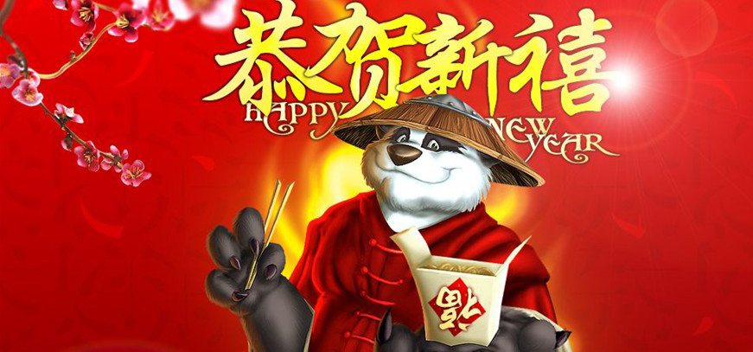
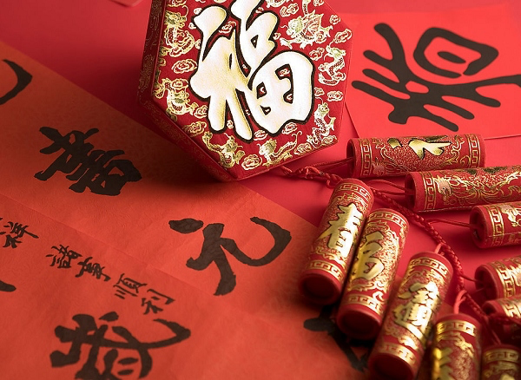
Made by: www.dudumama.com
Notes:
Chinese New Year is an important traditional Chinese holiday celebrated at the turn of the Chinese calendar.
In China, it is also known as the Spring Festival, the literal translation of the modern Chinese name.
Chinese New Year celebrations traditionally run from Chinese New Year's Eve, the last day of the last month of the Chinese calendar, to the Lantern Festival on the 15th day of the first month, making the festival the longest in the Chinese calendar
New Year's Eve and New Year's Day are celebrated as a family affair, a time of reunion and thanksgiving. The celebration was traditionally highlighted with a religious ceremony given in honor of Heaven and Earth, the gods of the household and the family ancestors.

Slide 3
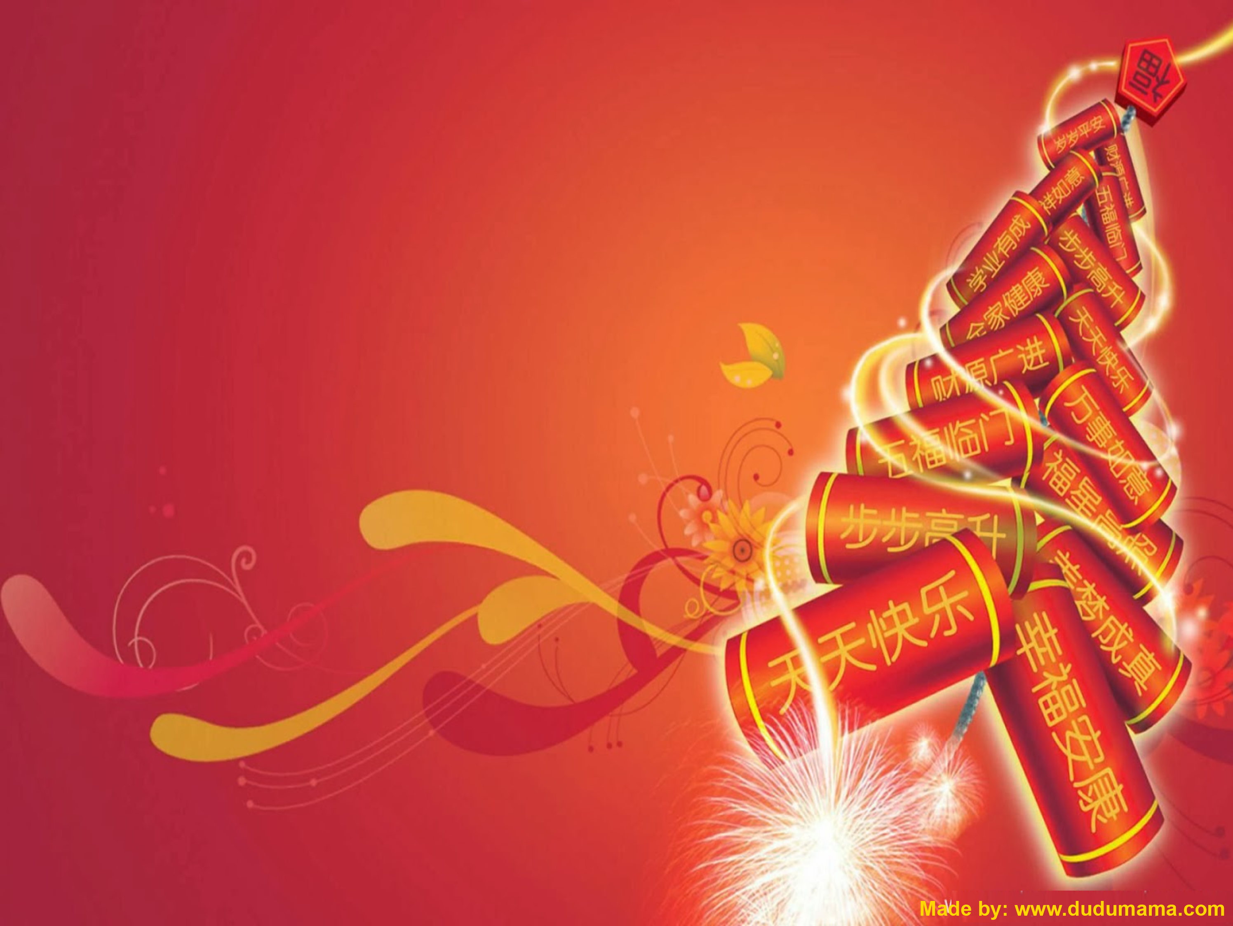
Chinese Zodiac
12 生肖

Slide 4
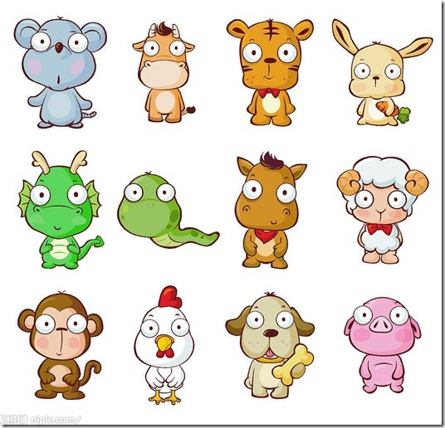
Made by: www.dudumama.com
Notes:
12 Animals for 12 Years

Slide 5
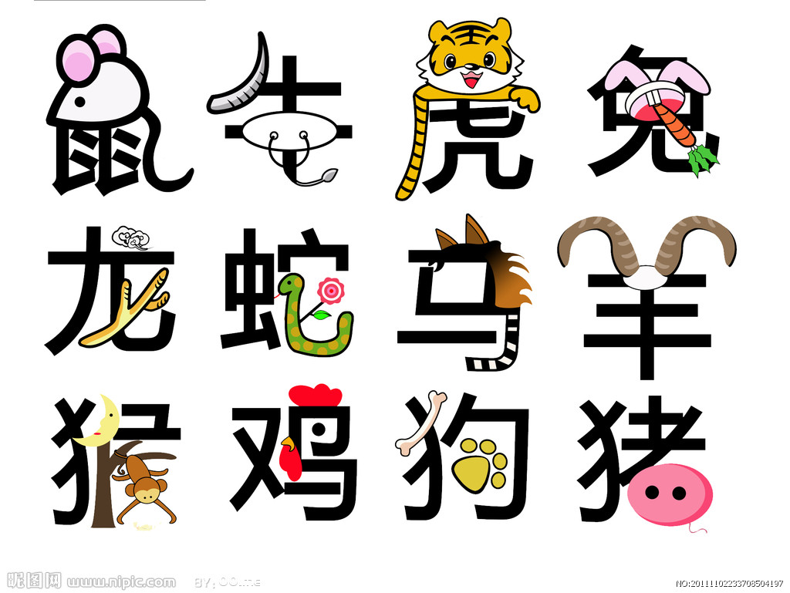
Made by: www.dudumama.com
Notes:
Chinese waiting of each animal

Slide 6
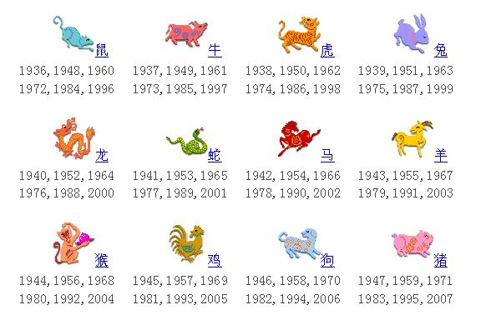
Made by: www.dudumama.com
Notes:
Which year were you born?

Slide 7
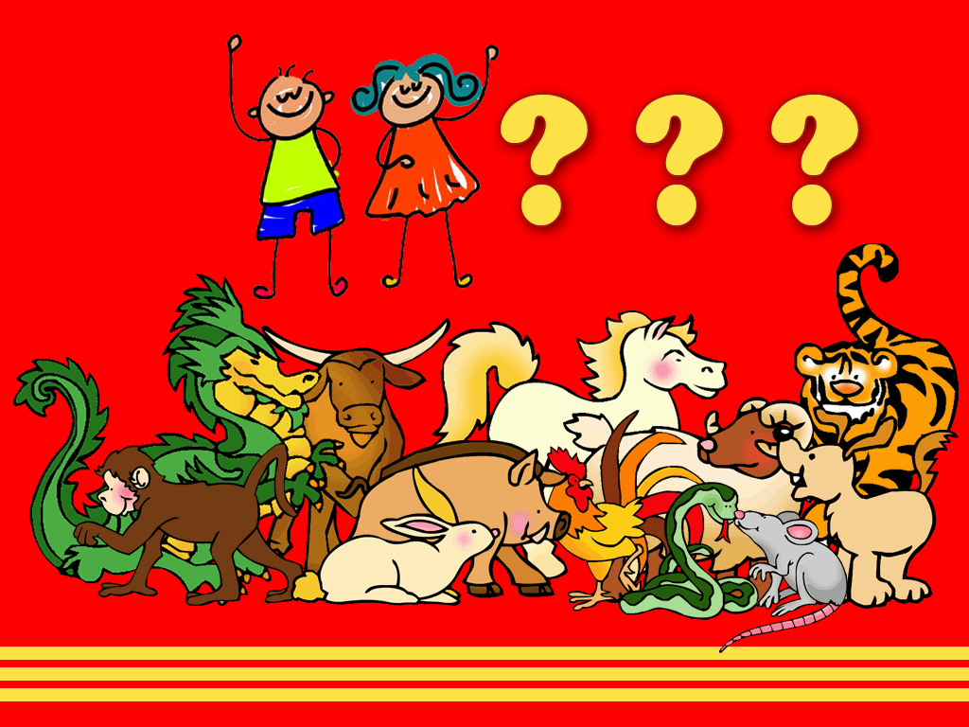
Made by: www.dudumama.com
Notes:
Guess which animal is for year 2015?

Slide 8
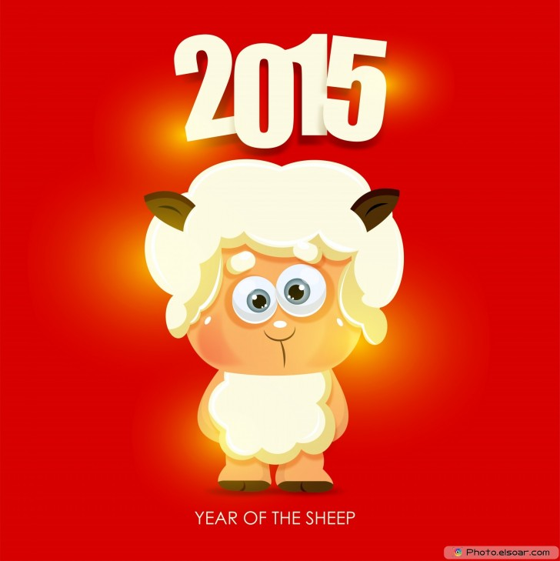
Made by: www.dudumama.com

Slide 9
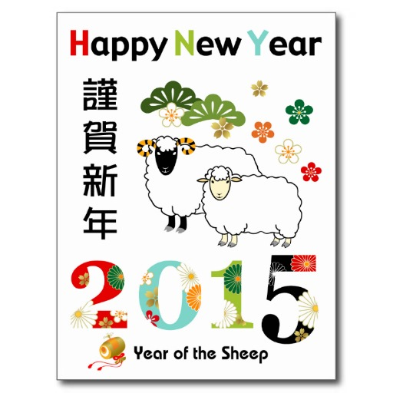
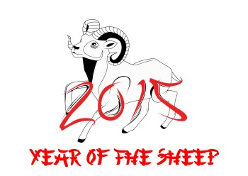
Made by: www.dudumama.com

Slide 10
Decoration
春节装饰

Slide 11
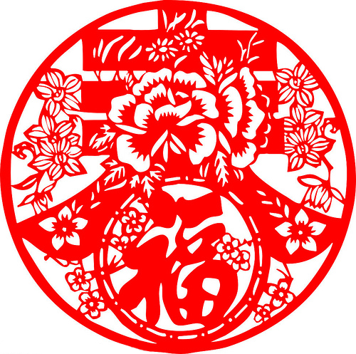
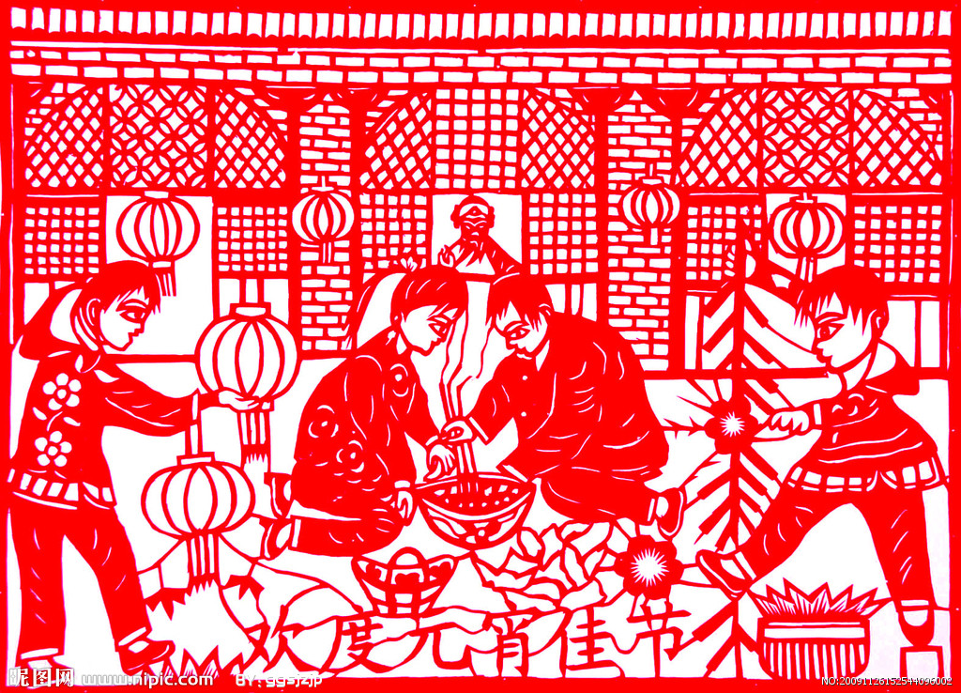
Paper Cuttings
剪 纸
Made by: www.dudumama.com

Slide 12
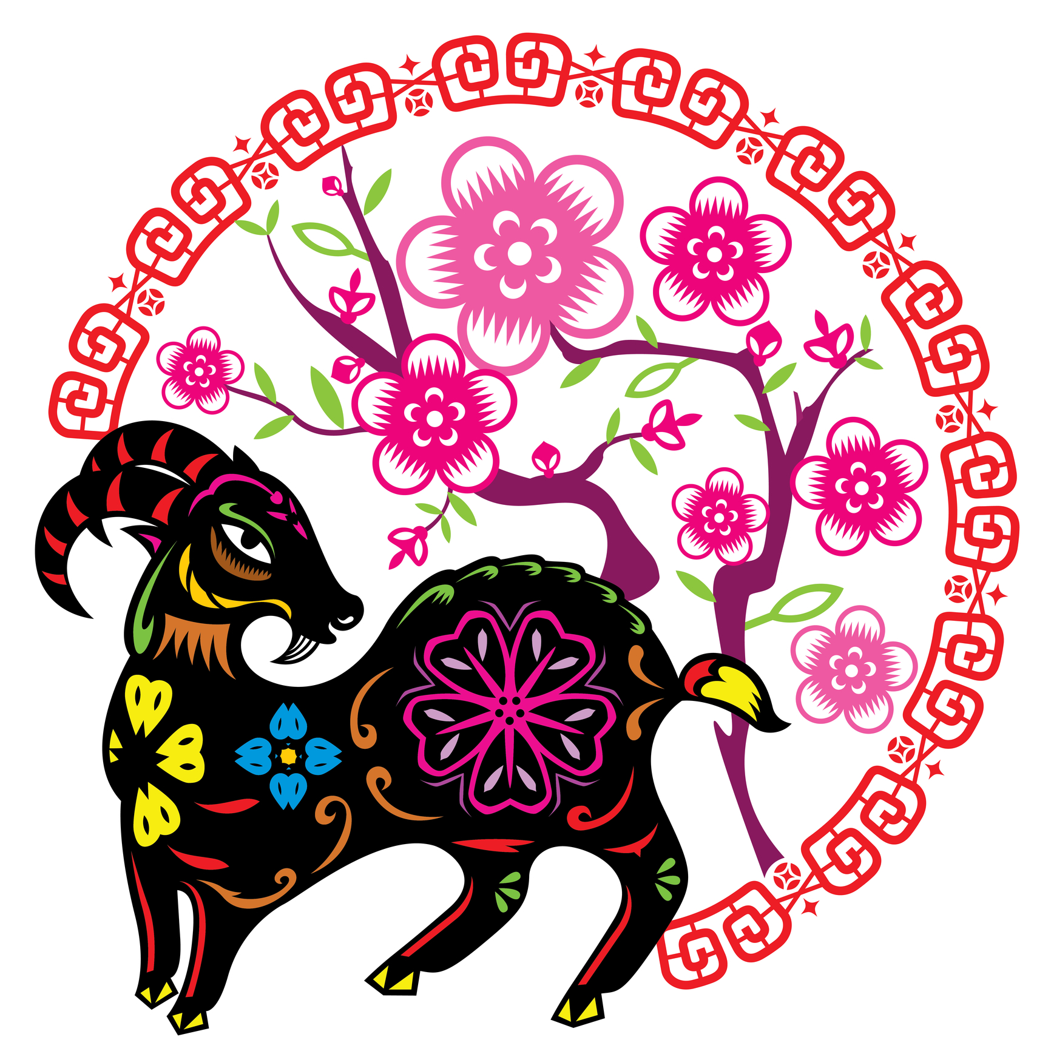
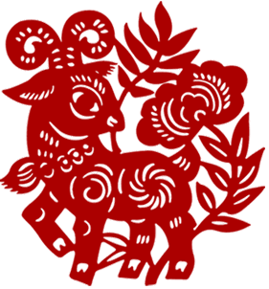
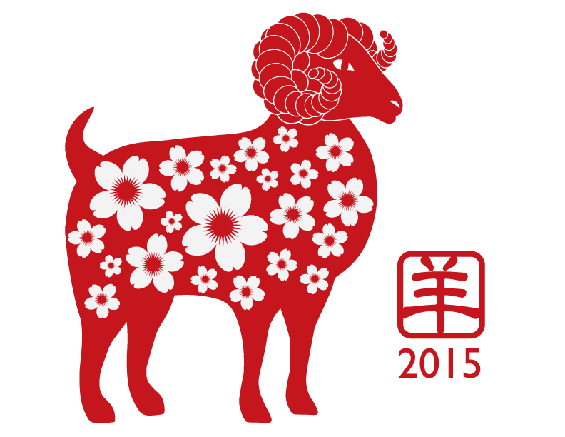
Made by: www.dudumama.com

Slide 13
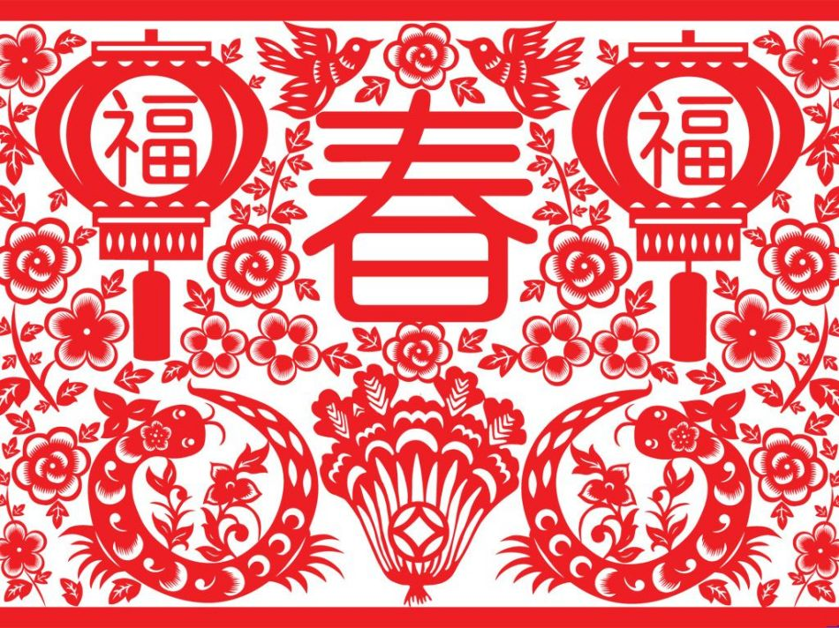
Made by: www.dudumama.com

Slide 14
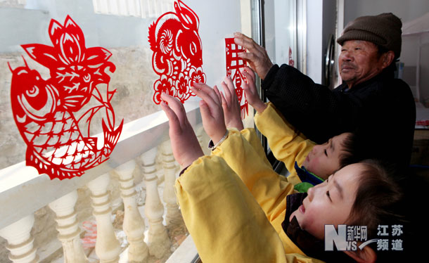
Made by: www.dudumama.com

Slide 15
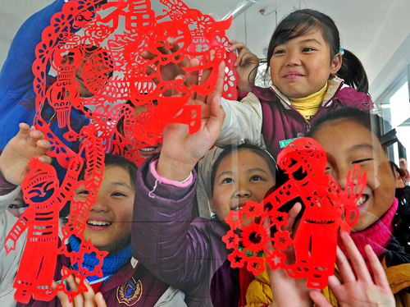
Made by: www.dudumama.com
Notes:
Stick the paper cuttings on the window.

Slide 16
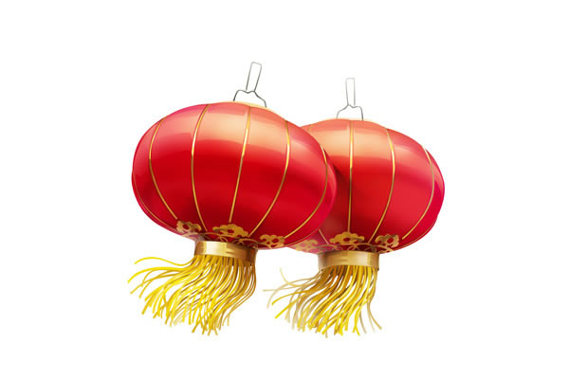
Chinese Lantern
灯 笼
Made by: www.dudumama.com
Notes:
The Lantern Festival is a Chinese festival celebrated on the fifteenth day of the first month in the lunisolar year in the lunar calendar marking the last day of the lunar New Year celebration.During the Lantern Festival, children go out at night to temples carrying paper lanterns and solve riddles on the lanterns (simplified Chinese: 猜灯谜; traditional Chinese: 猜燈謎; pinyin: cāidēngmí; Jyutping: caai1dang1mai4).^{[3][4]}

Slide 17
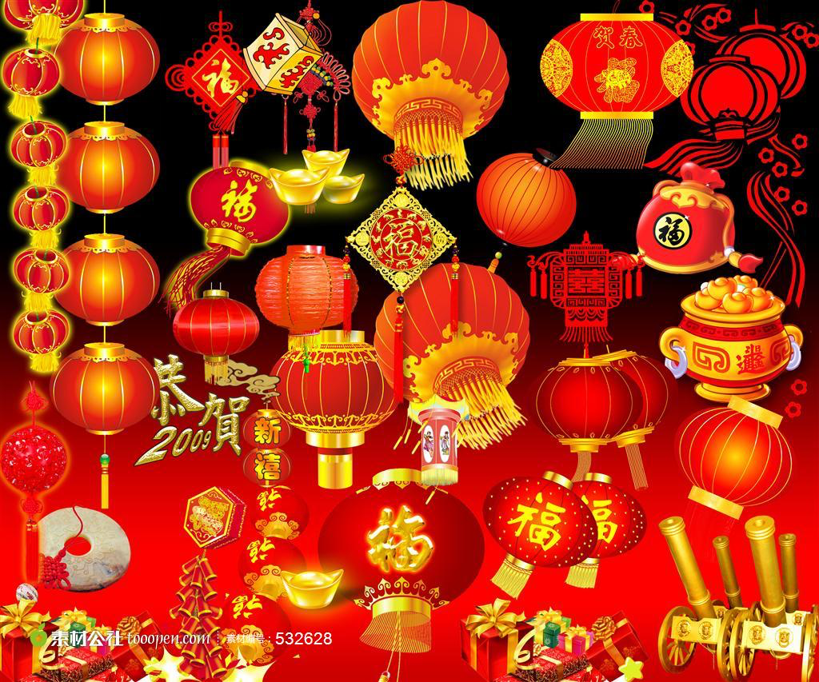
Made by: www.dudumama.com
Notes:
Different kind of Lanterns.

Slide 18
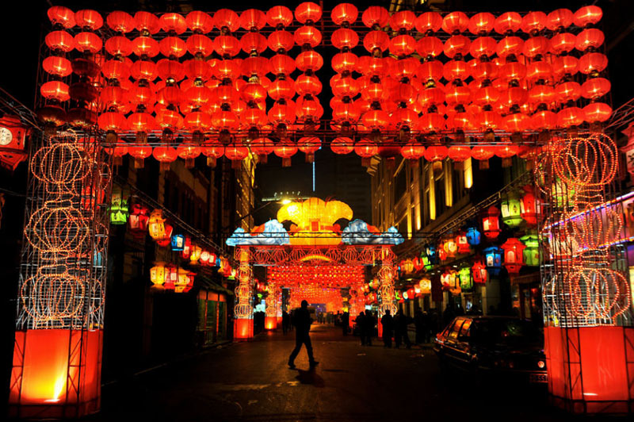
Made by: www.dudumama.com

Slide 19
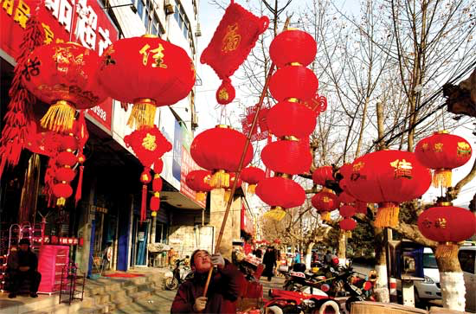
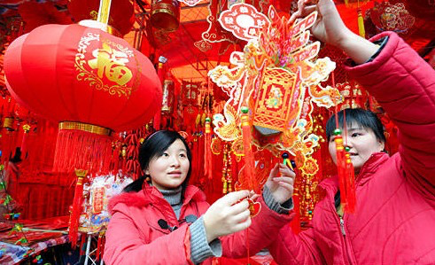
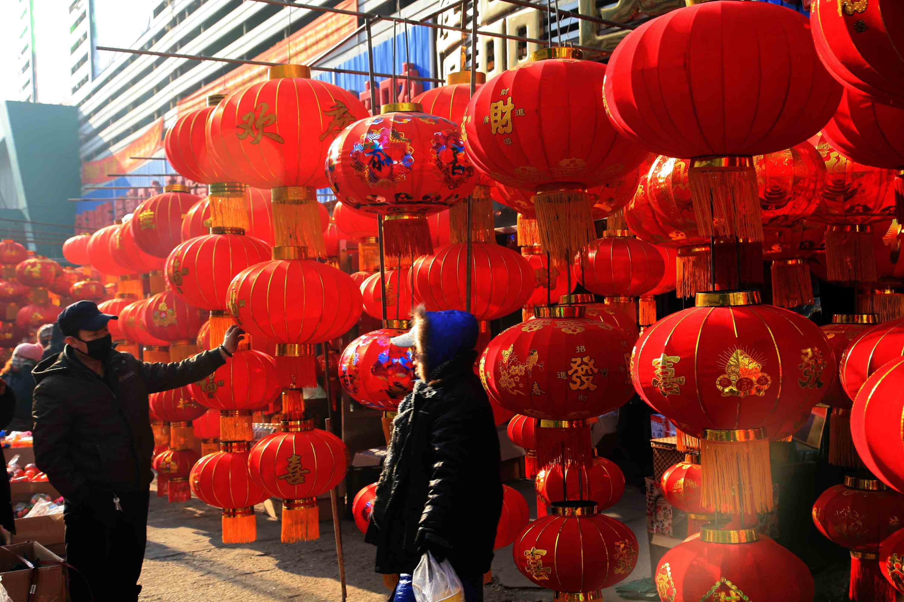
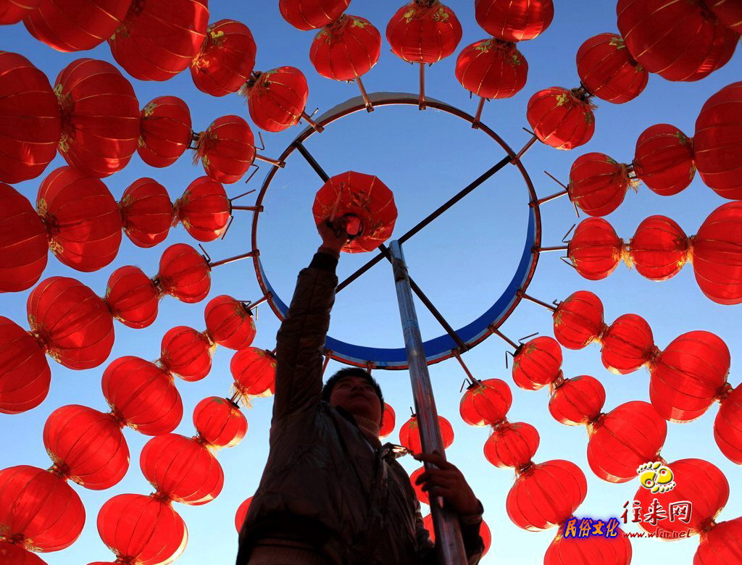
Made by: www.dudumama.com

Slide 20
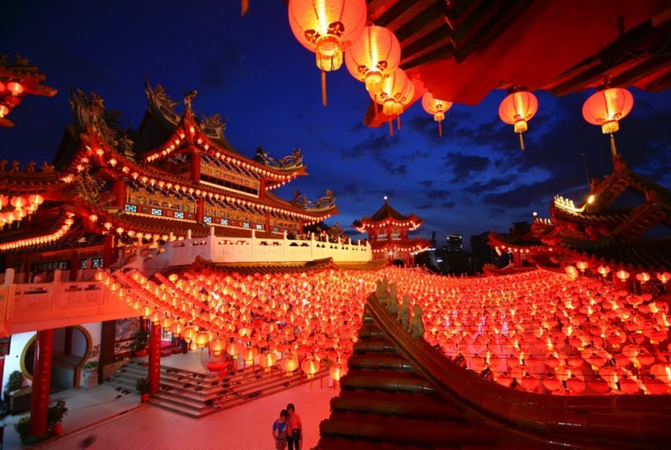
Made by: www.dudumama.com
Notes:
In more contemporary parades, large, elaborate electric lanterns have replaced the original candlelit lanterns. However, traces of many of the old traditions still remain.

Slide 21
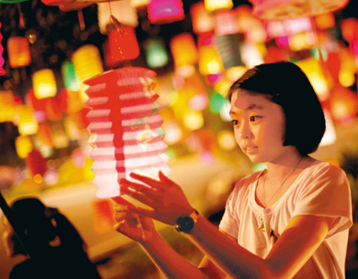
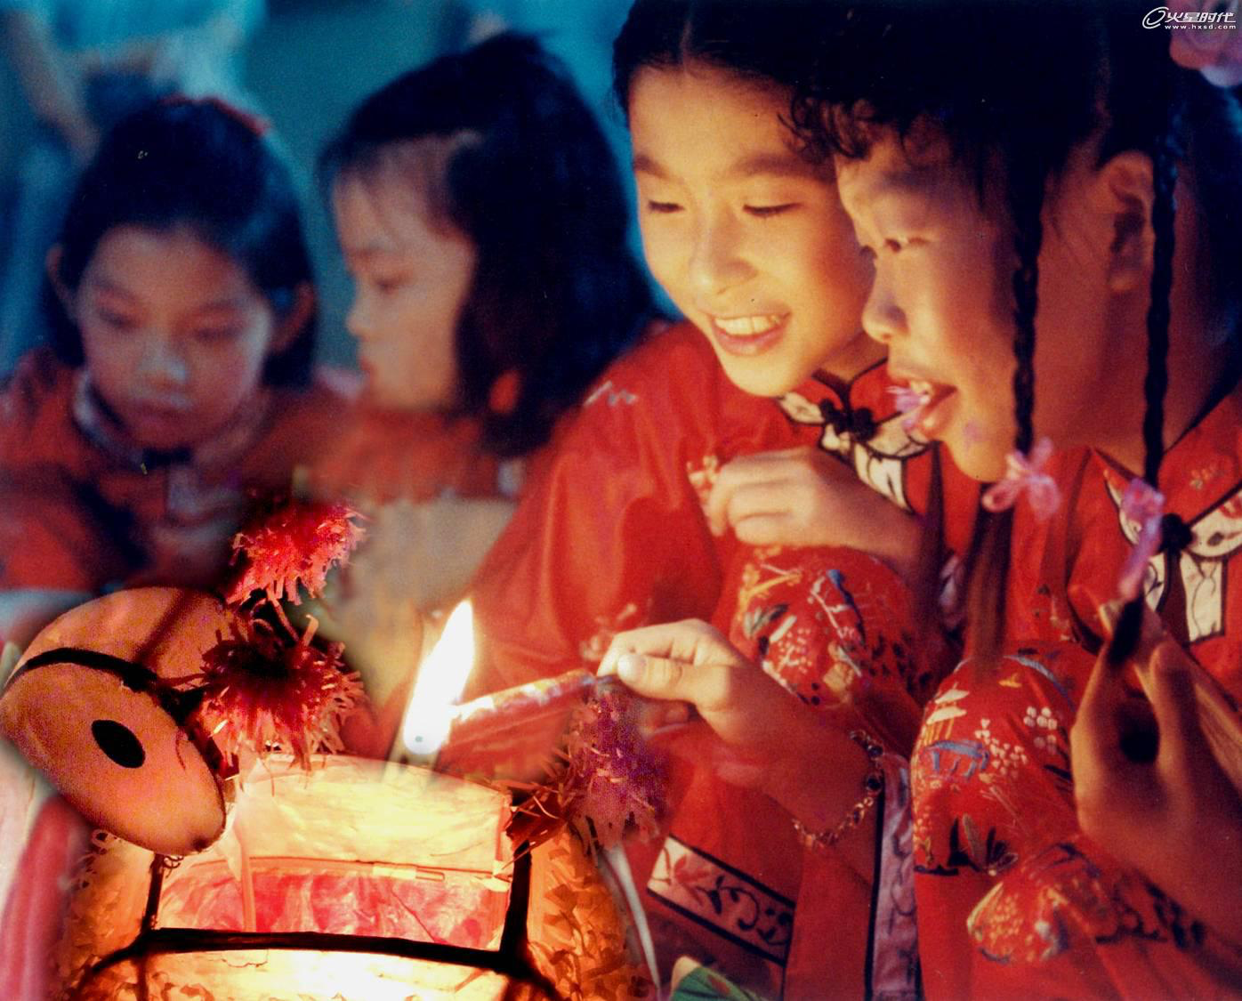
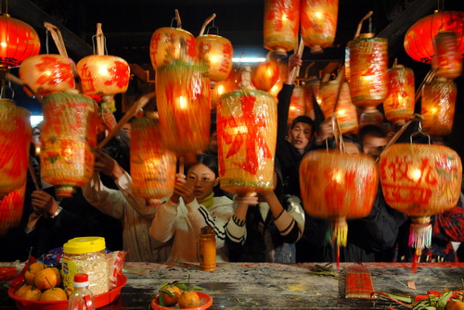
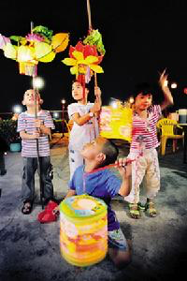
Made by: www.dudumama.com

Slide 22
Made by: www.dudumama.com
Notes:
Traditionally, Chinese adults and children alike gathered together and carried their own personally decorated, paper lanterns down the street.

Slide 23
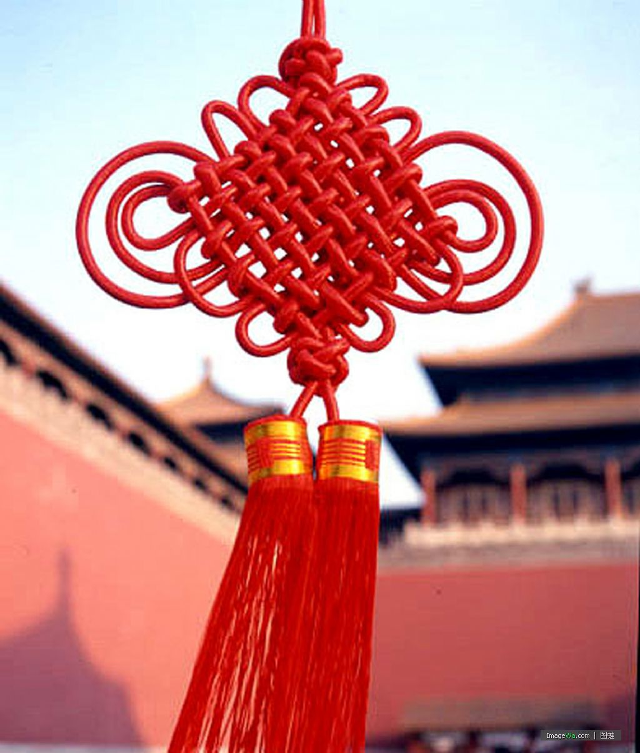
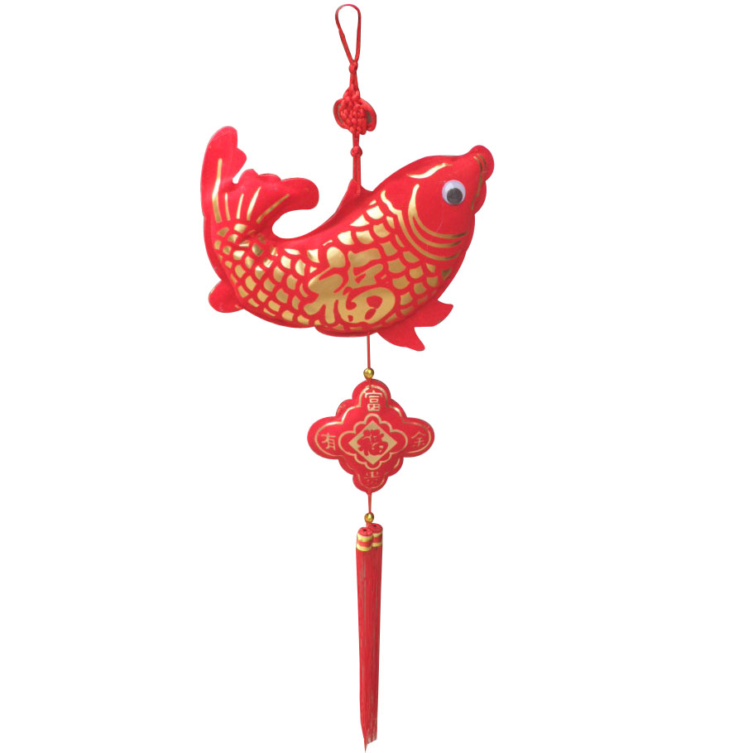
Chinese
Knotting
中国结
Made by: www.dudumama.com

Slide 24
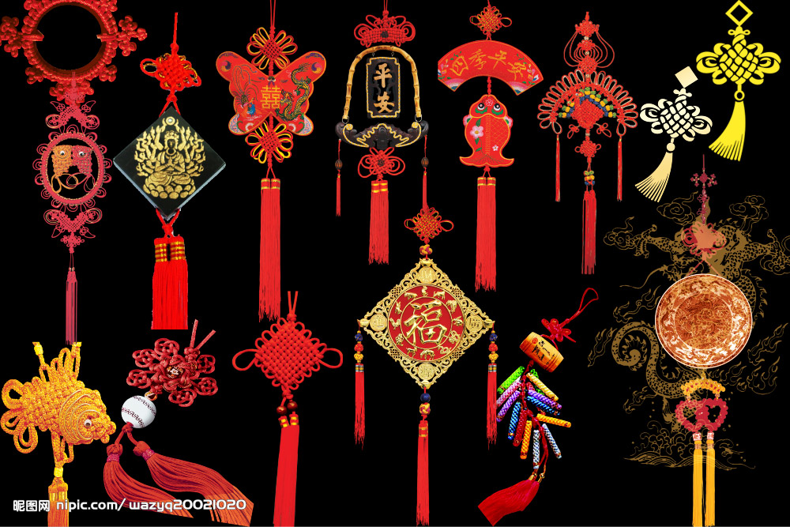
Made by: www.dudumama.com
Notes:
Chinese knotting (Chinese: 中國結; pinyin: Zhōngguó jié) is a decorative handicraft art that began as a form of Chinese folk art in the Tang and Song Dynasty (960-1279 AD) in China. It was later popularized in the Ming). The art is also referred to as "Chinese traditional decorative knots".^{[1]} In other cultures, it is known as "decorative knots".
Chinese knots are usually lanyard type arrangements where two cords enter from the top of the knot and two cords leave from the bottom. The knots are usually double-layered and symmetrical.^{[2]}

Slide 25
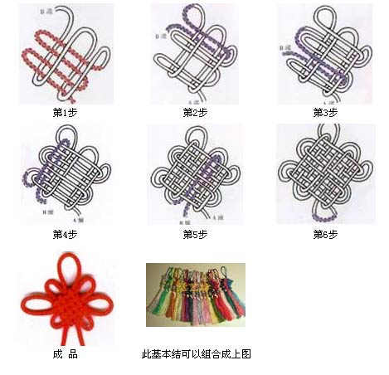
Making Chinese Knot
Made by: www.dudumama.com
Notes:
How to make a Chinese Knot

Slide 26
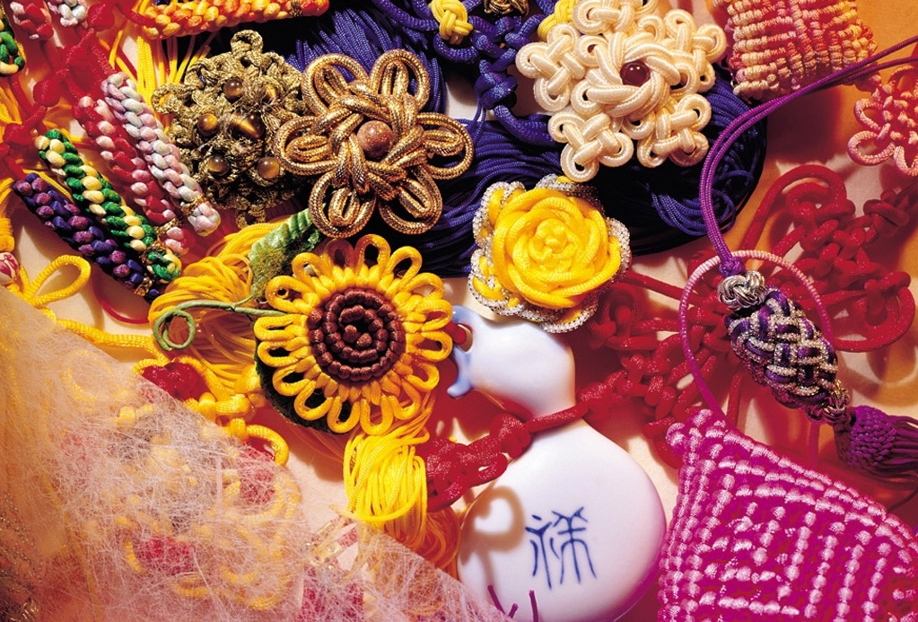
Made by: www.dudumama.com

Slide 27
New Year
Food
春节美食

Slide 28
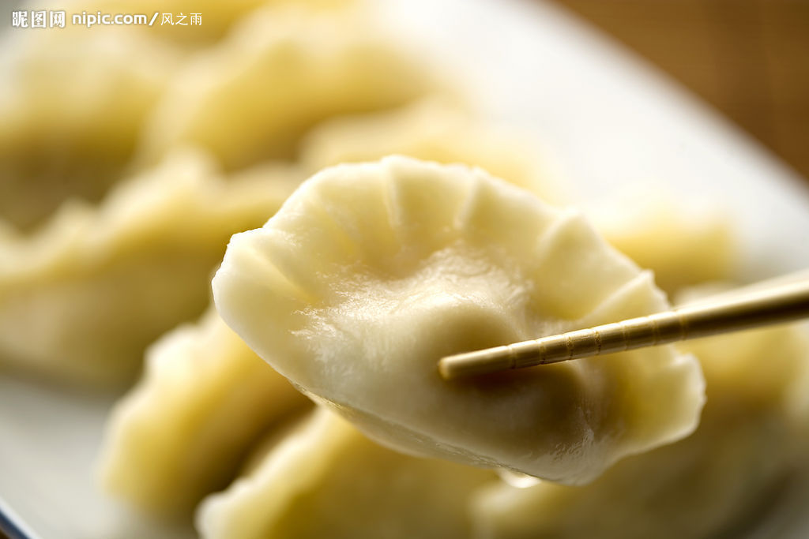
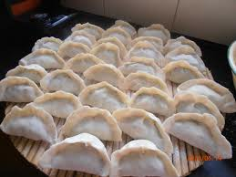
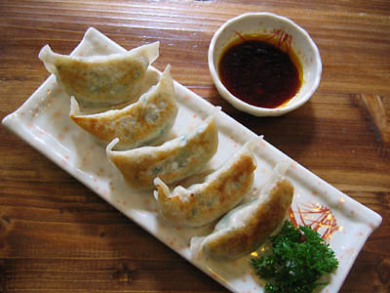
Chinese
Dumplings
饺子
Made by: www.dudumama.com
Notes:
Dumplings are very popular in Northern China. It is one of the main dishes for New Year's Eve dinner. Conversely, very few people in Southern China serve dumplings in New Year's Eve dinner.

Slide 29
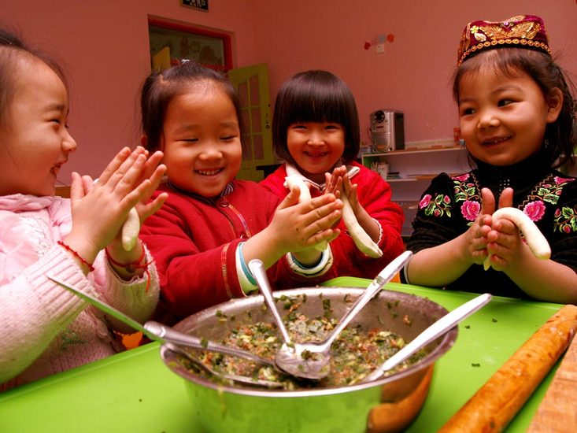
Made by: www.dudumama.com

Slide 30
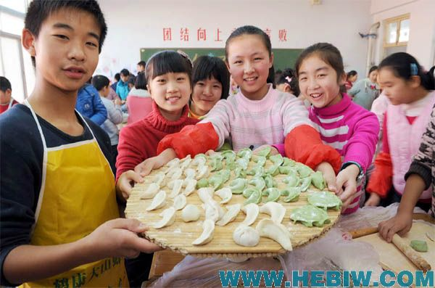
Made by: www.dudumama.com

Slide 31
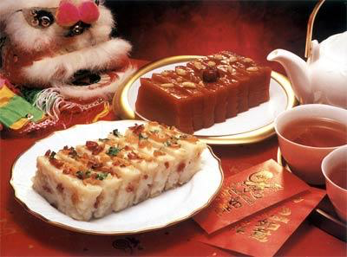
New Year Cake
— Nian Gao－
年糕
Made by: www.dudumama.com
Notes:
Niangao (nin gou in Cantonese), sometimes translated as year cake or Chinese New Year's cake, is a food prepared from glutinous rice and consumed in Chinese cuisine. It is available in Asian supermarkets and from health food stores. While it can be eaten all year round, traditionally it is most popular during Chinese New Year. It is also traditionally eaten during the Duanwu Festival. It is considered good luck to eat nian gao during this time, because "nian gao" is a homonym for "higher year." The Chinese word 粘 (nián), meaning "sticky", is identical in sound to 年, meaning "year", and the word 糕 (gāo), meaning "cake" is identical in sound to 高, meaning "high or tall". As such, eating nian gao has the symbolism of raising oneself taller in each coming year (年年高升 niánnián gāoshēng). It is also known as a rice cake. This sticky sweet snack was believed to be an offering to the Kitchen God, with the aim that his mouth will be stuck with the sticky cake, so that he can't badmouth the human family in front of the Jade Emperor.

Slide 32
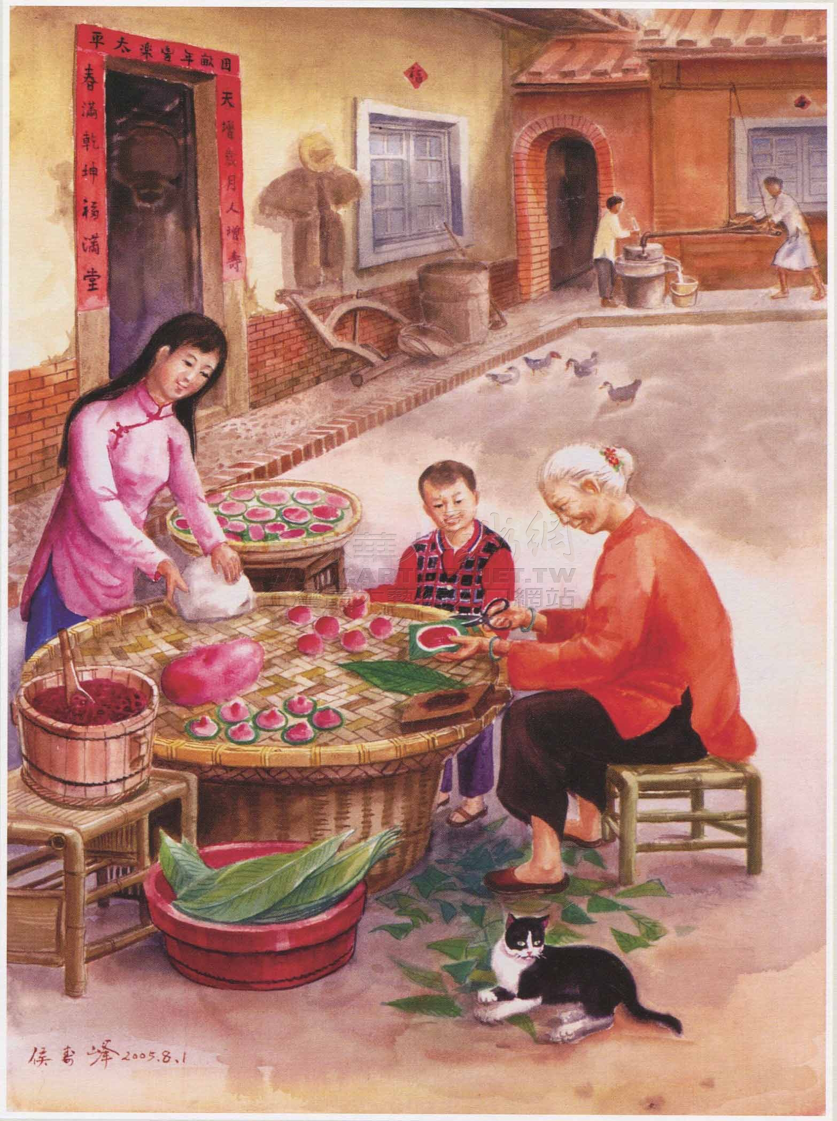
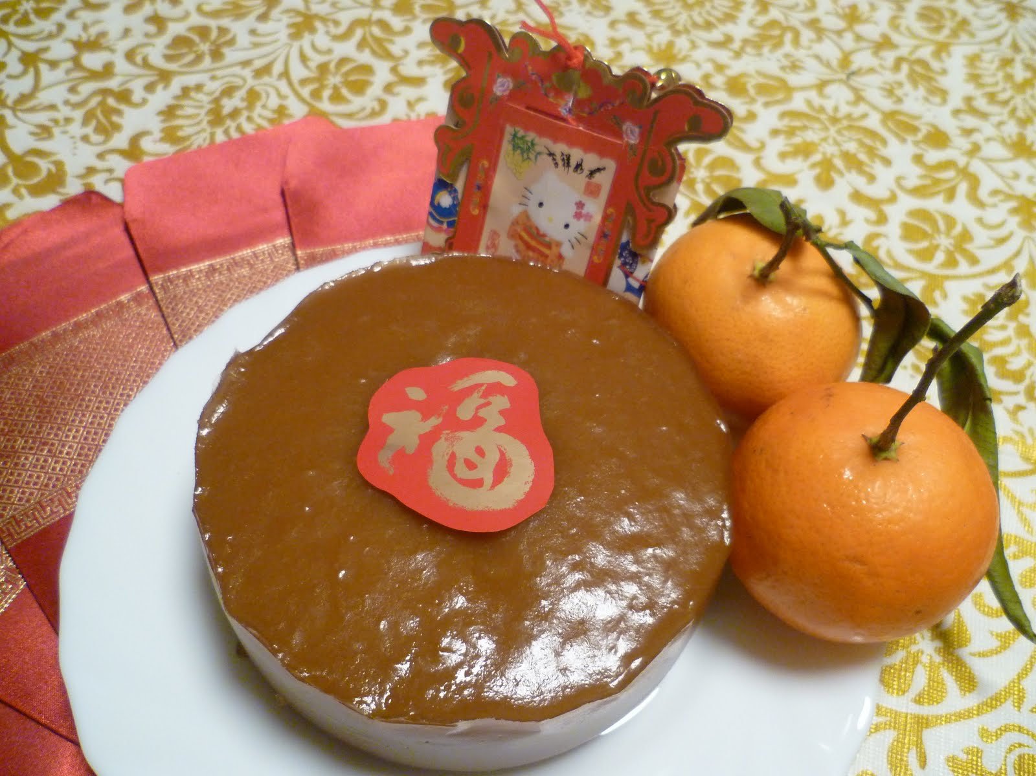
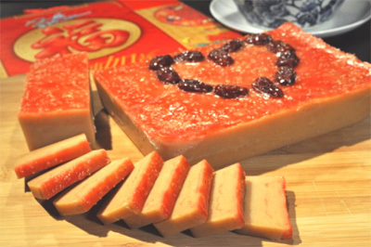
Made by: www.dudumama.com

Slide 33
Activities
活动

Slide 34
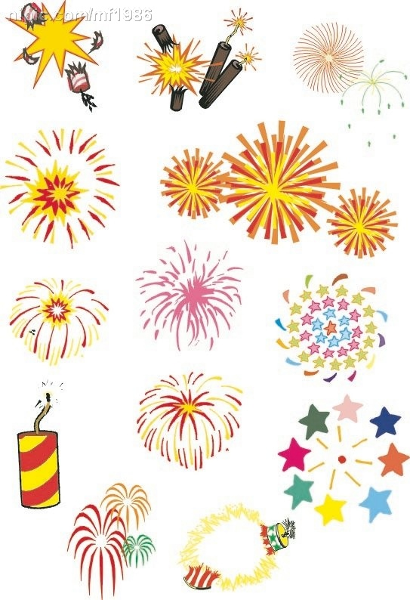
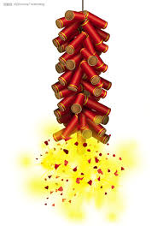
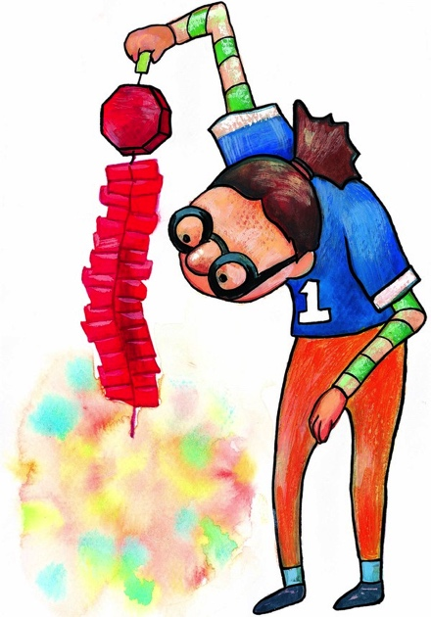
Fireworks
放炮
Made by: www.dudumama.com
Notes:
Fireworks are used to drive away the evil in China. Right after 12:00PM on New Year's Eve, fireworks will be launched to celebrate the coming of the New Year as well as to drive away the evil. It is believed that the person who launched the first firework of the New Year will obtain good luck.

Slide 35
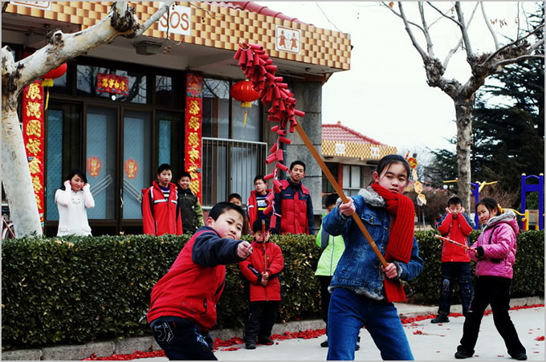
Made by: www.dudumama.com

Slide 36
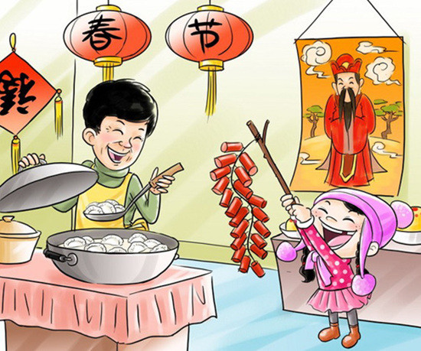
Made by: www.dudumama.com

Slide 37
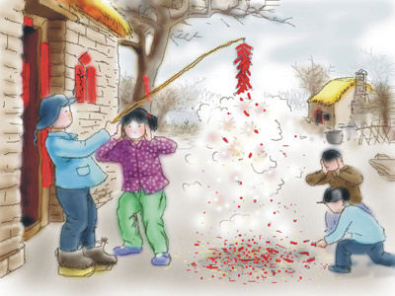
Made by: www.dudumama.com

Slide 38
Made by: www.dudumama.com

Slide 39
Made by: www.dudumama.com

Slide 40
Dragon Dance
舞龙
Made by: www.dudumama.com
Notes:
The dragon dance is often performed during Chinese New Year. Chinese dragons are a symbol of China, and they are believed to bring good luck to people, therefore the longer the dragon in the dance, the more luck it will bring to the community.^{[1]} The dragons are believed to possess qualities that include great power, dignity, fertility, wisdom and auspiciousness. The appearance of a dragon is both frightening and bold but it has a benevolent disposition, and so eventually became an emblem to represent imperial authority. The movements in a performance traditionally symbolize historical roles of dragons demonstrating power and dignity.

Slide 41
Made by: www.dudumama.com

Slide 42
Made by: www.dudumama.com

Slide 43
Tradition
传统

Slide 44
Red
Envelop
红包
Made by: www.dudumama.com
Notes:
Like Christmas in the West, people exchange gifts during the Spring Festival. The most common gifts are red envelopes. Red envelopes have money in, and are given to children and (retired) seniors. It is not a customs to give red envelopes to (working) adults. Read more on Chinese New Year Gift Ideas

Slide 45
Made by: www.dudumama.com

Slide 46
Made by: www.dudumama.com

Slide 47
Made by: www.dudumama.com

Slide 48
Antithetical Couplet
—Dui Lian－
对联
Made by: www.dudumama.com
Notes:
Dui Lian
This is also called antithetical couplet. It is a pair of lines of poetry, usually hand written on red paper and pasted on the front door. The two lines correspond in their metrical length and some properties of each character, such as meaning and tone. The ideal for a duilian is to have few words but deep meaning. For this reason, they use one character per word, as in Classical Chinese.

Slide 49
Made by: www.dudumama.com

Slide 50
Made by: www.dudumama.com

Slide 51
Traditional Costume
唐装
Made by: www.dudumama.com

Slide 52
Made by: www.dudumama.com

Slide 53
Made by: www.dudumama.com

Slide 54
Place your own photos here
Made by: www.dudumama.com

Slide 55
Made by: www.dudumama.com
Notes:
Chinese New Year is all about been together and have fun with the whole family.

Slide 56
Made by: www.dudumama.com

Slide 57
Xin Nian Kuai Le
Made by: www.dudumama.com
Notes:
New year greetings
Learn to say Happy New Year in Chinese!

Slide 58
Made by: www.dudumama.com

